Slide 1
Secure Data Hiding in Image Using Steganography
CAPSTONE PROJECT
Presented By: Deepti Vinayak Nayak
Student Name : Deepti Vinayak Nayak
College Name : BAPUJI INSTITUTE OF ENGINEERING & TECHNOLOGY, Davangere
Department : BE (Electrical and Electronics Engineering)

Slide 2
OUTLINE
Problem Statement
Technology used
Wow factor
End users
Result
Conclusion
Git-hub Link
Future scope

Slide 3
Problem Statement
Data security is a crucial concern in the digital world, especially when transmitting sensitive information. Traditionally encryption methods can be complex and require external storage for encrypted files. This project introduces an image-based encryption and decryption system that allows users to hide secret messages inside images securely. The decryption process is protected with a password, ensuring only authorized access.
Challenges Addressed:
Difficulty in securely sharing text messages.
Risk of data exposure in plaintext format.
Lack of simple encryption tools for non-technical users.

Slide 4
Technology used
Programming Language:
Python – Used for building encryption and decryption logic.
Libraries & Frameworks:
OpenCV – Handles image processing and manipulation.
Numpy – Supports array-based operations for embedding messages.
PyQt6 – Creates a user-friendly GUI for encryption and decryption.
Platforms:
Runs on Windows, Linux and macOS with python installed.

Slide 5
Wow factors
Steganography-based encryption – Instead of traditional encryption, the message is embedded within the pixel values of an image.
User-friendly GUI – No need for command-line operations; everything is handled through an interactive interface.
Password protection - The message can only be decrypted with the correct password, adding a layer of security.
No need for additional storage – The message is stored inside the image itself, eliminating the need for external encrypted files.
Lossless data hiding using pixel value manipulation instead of traditional cryptographic techniques.
Works on any standard image file format (PNG recommended for best results).

Slide 6
End users
Cybersecurity Enthusiasts – To explore encryption steganography techniques.
Journalists & Activists - Securely share confidential information without detection.
Students & Researchers - Learn about cryptography and image processing.
Photography & Designers – Protect copyright information within images.
General Users – Hide private messages or data securely within images.
Government & Defense – Secure message transmission without raising suspicion.
Software Developers – Learning steganography concepts and their applications.

Slide 7
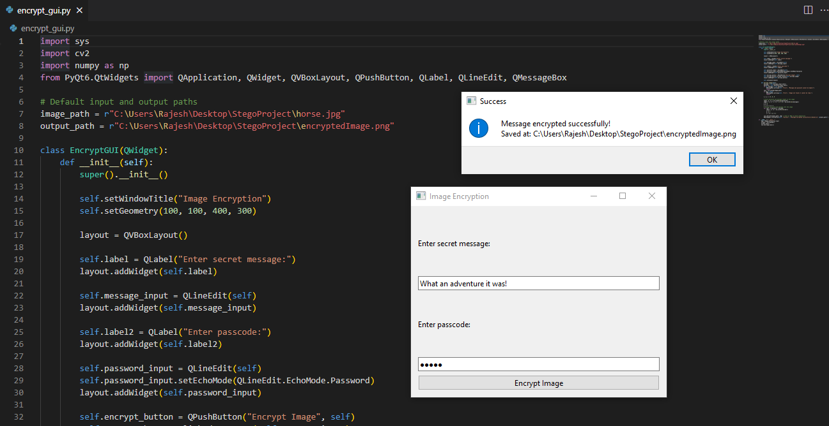
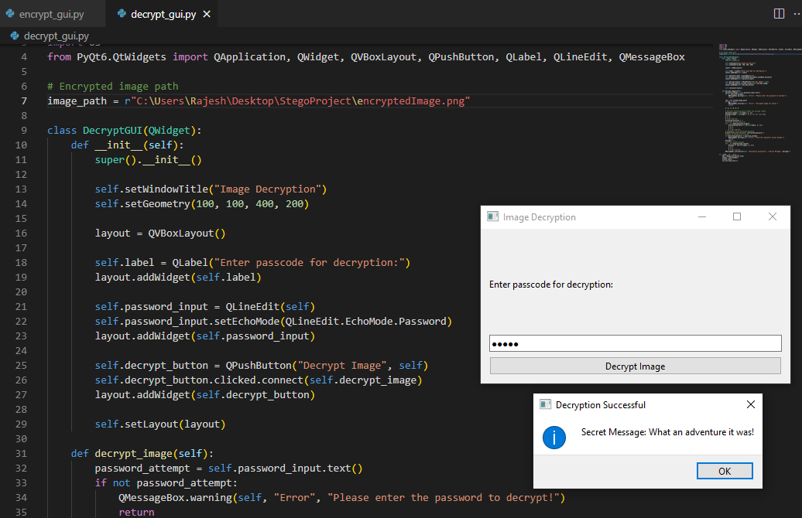


Results
Image Encryption with GUI
Image Decryption with GUI
Input Image:
Output/Encrypted Image:

Slide 8
Conclusion
This project provides a simple yet effective way to securely encrypt messages within images using steganography and password protection.
By integrating a graphical user interface(GUI), the system is made accessible to both technical and non-technical users.
The use of OpenCV and NumPy enables fast and efficient message embedding and extraction without significant image distortion.
The project successfully demonstrates a practical application of image-based cryptography for secure communication.
Future improvements can make it more robust, secure, and scalable.

Slide 9
GitHub Link
https://github.com/DeeptiVNayak/Secure-Data-Hiding-in-Image-Using-Steganography.git

Slide 10
Future scope(optional)
Enhanced Security – Implement AES or RSA encryption alongside steganography for dual-layer security approach.
Support for Multiple Image Formats – Extend compatibility beyond PNG to formats like JPG, BMP and TIFF.
Mobile & Web Integration – Develop a Mobile app or Web-based version for wider accessibility.
Deep Learning for Image Security – Explore AI-Based detection of tampered images and improve security features.
Advanced Encryption Techniques – Integrate AES encryption before embedding text in images.
Support for Audio & Video Steganography – Expanding beyond images.
AI-based Detection Prevention – Ensuring messages stay undetectable from modern forensic tools.
Mobile App & Web Version – Expanding accessibility beyond desktops.
Multi-Layer Security – Combining steganography with blockchain for ultra-secure communication.

Slide 11
THANK YOU

